Slide 1

Operational Risk Overview
Strengths, Weaknesses, Tools, & Techniques
Notes:
This presentation will provide an overview of the current state of Company XYZ’s enterprise risk management, particularly their abilities and opportunities to leverage data analytics for identifying and mitigating operational risk events due to fraduelent insurance claims.

Slide 2
What is operational risk?
“the risk of loss resulting from inadequate or failed processes, people and systems or from external events” (Girling, 2013)
Seven Categories (according to Basel II standards)
  Internal Fraud
  External Fraud
  Employment Practices and Workplace Safety
  Clients, Products, and Business Practices
  Damage to Physical Assets
  Business Disruption and System Failures
  Execution, Delivery, and Process Management
Notes:
Operational risk is the risk of loss resulting from inadequate or failed processes, people and systems or from external events. This includes legal risk, but excludes strategic and reputational risk. Operational risk can be broken down into seven categories that have been proven to capture all business situations that can be considered operational risk events.

Slide 3
Strengths
strong history of using data analytics for managaing market, credit, and insurance risks
industry-standard special investigations unit (SIU)
claims adjudication system
demonstrated commitment to effective risk management through executing the risk and control self-assessment (RCSA)
opportunity to create a corporate operational risk function
Notes:
Company XYZ has some established programs, policies, strategies, and practices that will assist with their operational risk assessment objectives. They have shown a strong history of using data analytics for managaing market, credit, and insurance risks. They already have the ability to identify potential fraud with their claims adjudication system. They have already demonstrated their commitment to effective risk management by executing the risk and control self-assessment that initially revealed operational risk weaknesses.

Slide 4
Weaknesses
Macro Risks
  External Fraud
    payments for fraduelent insurance claims
    losses due to acts of a type intended to defraud, misappropriate property, or circumvent the law, by a third party
Micro Risks
  High claim volume
  Disconnected operational risk management practices
  Lack of communication and transparency
Notes:
The largest risk that Company XYZ faces is external fraud due to fraudelent injury claims from automobile accidents. The special investigations unit is understaffed and overwhelmed with the volume of claims and they are unable to properly investigate the most suspicious claims without an enhanced operational risk management function. The organization also suffers from disconnected systems and poor communication when it comes to risk identification and escalation.

Slide 5
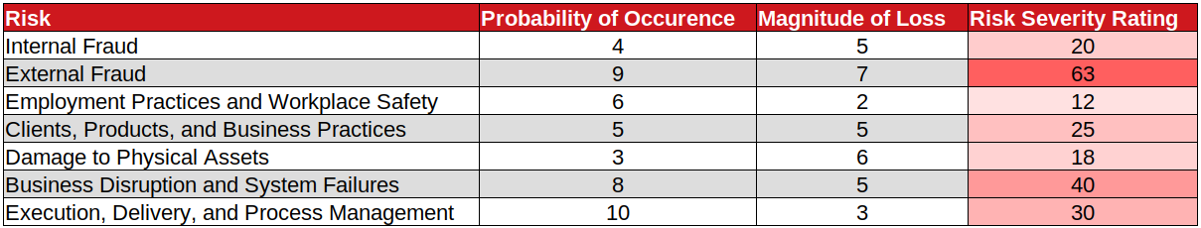
Operational Risks Categories
Notes:
This table shows that all seven categories of operational risk are present in Company XYZ’s activities, but external fraud is the most severe risk due to its extremely high likelihood and significant magnitude.

Slide 6
Tools
Enterprise Risk Management Products
  LogicGate Risk Cloud
  Sword GRC Active Risk Manager
  Onspring Enterprise Risk Management
Benefits
  cloud-based and highly configurable, meaning they provide a single view of risk
  data collection and risk escalation for business users
  information and analysis via reports, dashboards, and alerts
  embeds risk awareness into the culture of an organization
  flexible scoring for ranking and analyzing claims
Notes:
Purchasing a risk management system from a third party vendor is an effective way of streamlining and improving an organization’s enterprise risk management function. These products are cloud-based and highly configurable, meaning they provide a single view of risk. They provide data collection and risk escalation for business users as well as information and analysis via reports, dashboards, and alerts for risk professionals and senior management. Additionally, buying in to an ERM system at the highest level embeds risk awareness into the culture of an organization. “Increasing the focus on risk...allows risk to be considered more openly and breaks down silos with respect to how risk is managed.” (Kreiser)

Slide 7
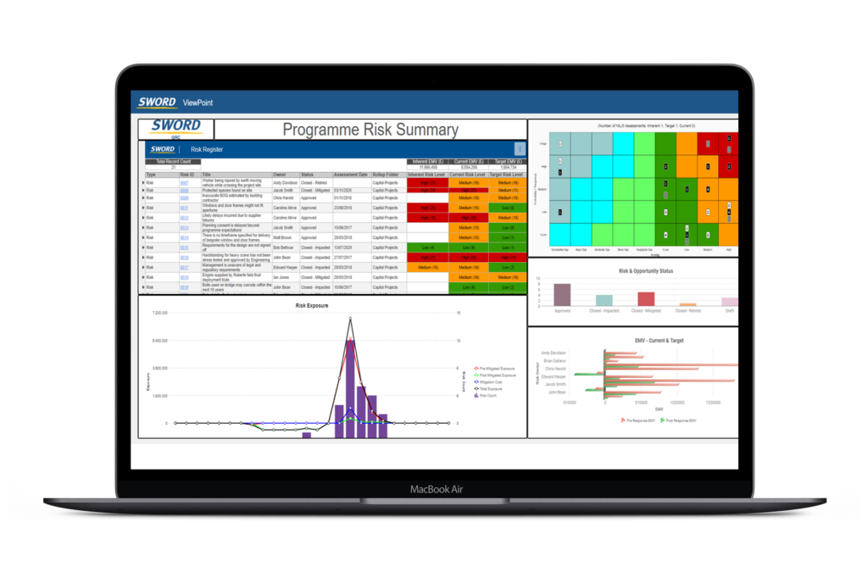
Sword GRC Active Risk Manager
Notes:
This image is a view of the Sword GRC Active Risk Manager system. It is clear that the system provides important risk information in an simple manner. It also makes it easy to collaborate and communicate with others within the system, enhancing operational risk management practices.

Slide 8
Techniques
Data Analytics
  Evidence-based approach to risk management
  Qualitative & quantitative analysis
  Statistical methods
    Principal component analysis
    Regression analysis
Visualization
  “makes it easier to communicate your ideas and findings to other people” (Healy, 2019)
  Point & Click tools
    Tableau, Spotfire
  Code-based tools
    R & Python
    Dashboards
      R Shiny
      Python Dash
Notes:
Data analytics and visualization techniques will be key elements of Company XYZ’s efforts to identify and investigate suspicious claims. Qualitative analysis, such as simply ranking risks as high, medium, or low, can help determine investiagtional priorities. Quantitative analysis can then assist the investigations by providing information and identifying critical factors. Data analytics can take risk management even further with robust statistical methods and frameworks for statistical reasoning. Visualization is the best way to communicate information, whether it is descriptive of what has happened or predictive of what might happen in the future.

Slide 9
References
Girling, P. X. (2013). Operational Risk Management: A Complete Guide to a Successful Operational Risk Framework. Wiley Professional Development (P&T). Retrieved from
https://mbsdirect.vitalsource.com/books/9781118983430
Healy, Kieran. (2019). Data Visualization: A Practical Introduction. Princeton University Press.
Kreiser, Jim. (2013). Five Benefits of Enterprise Risk Management. CliftonLarsonAllen. Retrieved from https://www.claconnect.com/resources/articles/five-benefits-of-enterprise-risk- management
Sword-GRC. (2021). Sword Active Risk Manager Book A Demo. Sword-GRC. Retrieved from https://sword- grc.com/sword-active-risk-manager-book-a-demo/?utm_source=Capterra

